Slide 1
Red-Black Trees
6
v
3
8
z
4
Red-Black Trees
Notes:
Red-Black Trees

Slide 2
From (2,4) to Red-Black Trees
A red-black tree is a representation of a (2,4) tree by means of a binary tree whose nodes are colored red or black
In comparison with its associated (2,4) tree, a red-black tree has
  same logarithmic time performance
  simpler implementation with a single node type
4
3 5
2 6 7
4
5
3
6
OR
3
5
2
7
Red-Black Trees

Slide 3
Red-Black Trees
A red-black tree can also be defined as a binary search tree that satisfies the following properties:
  Root Property: the root is black
  External Property: every leaf is black
  Internal Property: the children of a red node are black
  Depth Property: all the leaves have the same black depth
9
4
15
2
6
12
21
7
Red-Black Trees

Slide 4
Height of a Red-Black Tree
Theorem: A red-black tree storing n items has height O(log n)
Proof:
  The height of a red-black tree is at most twice the height of its associated (2,4) tree, which is O(log n)
The search algorithm for a binary search tree is the same as that for a binary search tree
By the above theorem, searching in a red-black tree takes O(log n) time
Red-Black Trees

Slide 5

Insertion
To insert (k, o), we execute the insertion algorithm for binary search trees and color red the newly inserted node z unless it is the root
  We preserve the root, external, and depth properties
  If the parent v of z is black, we also preserve the internal property and we are done
  Else (v is red ) we have a double red (i.e., a violation of the internal property), which requires a reorganization of the tree
Example where the insertion of 4 causes a double red:
6
6
v
v
3
8
3
8
z
z
4
Red-Black Trees

Slide 6
Remedying a Double Red
Consider a double red with child z and parent v, and let w be the sibling of v
Case 1: w is black
  The double red is an incorrect replacement of a 4-node
  Restructuring: we change the 4-node replacement
Case 2: w is red
  The double red corresponds to an overflow
  Recoloring: we perform the equivalent of a split
w
4
v
w
4
v
2
z
7
2
z
7
6
6
4 6 7
2 4 6 7
.. 2 ..
Red-Black Trees

Slide 7
Restructuring
A restructuring remedies a child-parent double red when the parent red node has a black sibling
It is equivalent to restoring the correct replacement of a 4-node
The internal property is restored and the other properties are preserved
z
4
6
w
v
v
2
7
4
7
z
w
6
2
4 6 7
4 6 7
.. 2 ..
.. 2 ..
Red-Black Trees

Slide 8
Restructuring (cont.)
There are four restructuring configurations depending on whether the double red nodes are left or right children
2
6
6
2
6
2
4
4
4
4
2
6
4
2
6
Red-Black Trees

Slide 9
Recoloring
A recoloring remedies a child-parent double red when the parent red node has a red sibling
The parent v and its sibling w become black and the grandparent u becomes red, unless it is the root
It is equivalent to performing a split on a 5-node
The double red violation may propagate to the grandparent u
w
4
v
w
4
v
2
z
7
2
z
7
6
6
… 4 …
2 4 6 7
2
6 7
Red-Black Trees

Slide 10
Analysis of Insertion
Algorithm insert(k, o)
1. We search for key k to locate the insertion node z
2. We add the new entry (k, o) at node z and color z red
3. while doubleRed(z)
if isBlack(sibling(parent(z)))
  z ← restructure(z)
  return
else { sibling(parent(z) is red }
  z ← recolor(z)
Recall that a red-black tree has O(log n) height
Step 1 takes O(log n) time because we visit O(log n) nodes
Step 2 takes O(1) time
Step 3 takes O(log n) time because we perform
  O(log n) recolorings, each taking O(1) time, and
  at most one restructuring taking O(1) time
Thus, an insertion in a red-black tree takes O(log n) time
Red-Black Trees

Slide 11
Deletion
To perform operation remove(k), we first execute the deletion algorithm for binary search trees
Let v be the internal node removed, w the external node removed, and r the sibling of w
  If either v of r was red, we color r black and we are done
  Else (v and r were both black) we color r double black, which is a violation of the internal property requiring a reorganization of the tree
Example where the deletion of 8 causes a double black:
6
6
v
r
3
8
3
r
w
4
4
Red-Black Trees

Slide 12
Remedying a Double Black
The algorithm for remedying a double black node w with sibling y considers three cases
Case 1: y is black and has a red child
  We perform a restructuring, equivalent to a transfer , and we are done
Case 2: y is black and its children are both black
  We perform a recoloring, equivalent to a fusion, which may propagate up the double black violation
Case 3: y is red
  We perform an adjustment, equivalent to choosing a different representation of a 3-node, after which either Case 1 or Case 2 applies
Deletion in a red-black tree takes O(log n) time
Red-Black Trees

Slide 13
Red-Black Tree Reorganization
Insertion | remedy double red
Red-black tree action | (2,4) tree action | result
restructuring | change of 4-node representation | double red removed
recoloring | split | double red removed or propagated up
Deletion | remedy double black
Red-black tree action | (2,4) tree action | result
restructuring | transfer | double black removed
recoloring | fusion | double black removed or propagated up
adjustment | change of 3-node representation | restructuring or recoloring follows
Red-Black Trees

Slide 14
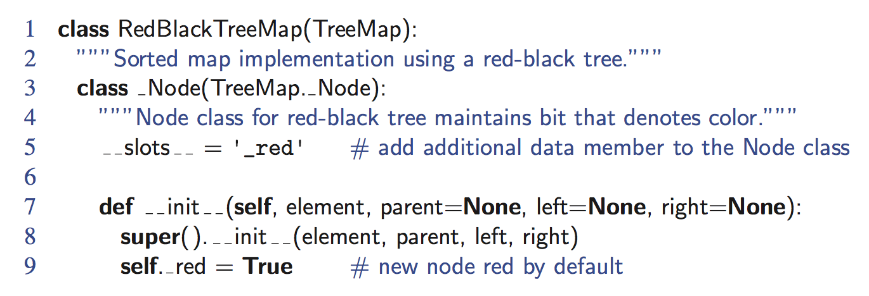
Python Implementation
Red-Black Trees

Slide 15
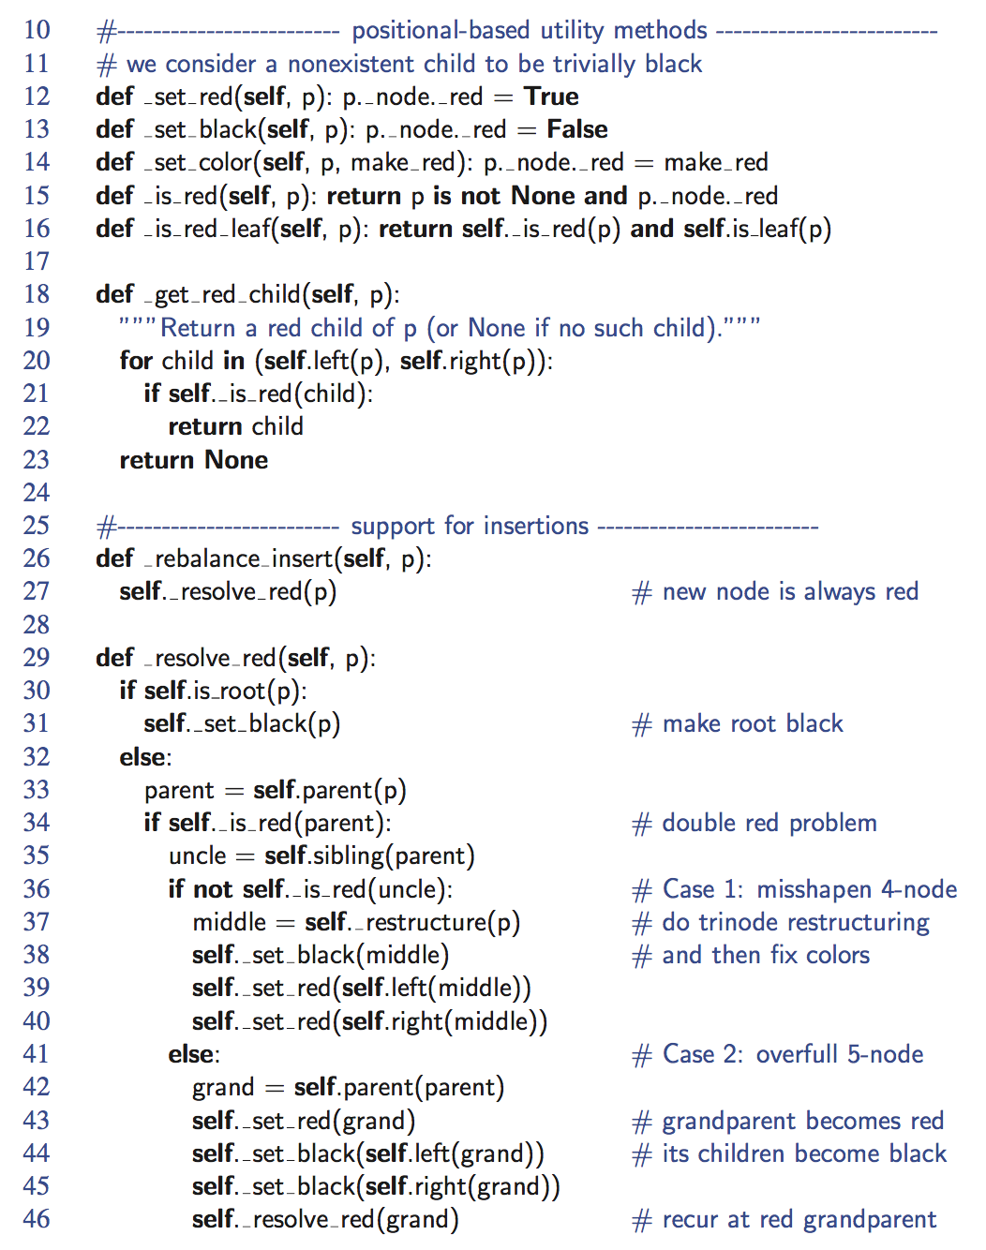
Python Implementation, Part 2
Red-Black Trees

Slide 16
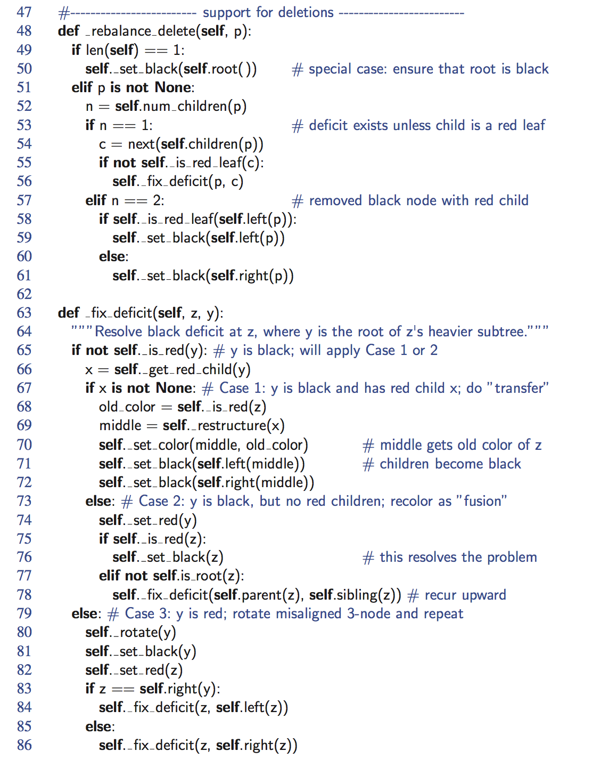
Python Implementation, end
Red-Black Trees

